Slide 1





Wi-Fi (IEEE 802.11) Security
By: Ramah Juha

Slide 2
Wi-Fi (IEEE 802.11) Security Overview
IEEE 802.11 is the standard that defines wireless networking protocols (Wi-Fi).
Wireless networks are inherently vulnerable due to the open nature of radio communication.
Multiple encryption protocols have been introduced over time to improve security:
WEP – Weak and easily cracked.
WPA – Improved security, introduced TKIP.
WPA2 – Stronger encryption using AES.
WPA3 – Latest standard with improved protection against offline attacks.
Despite encryption, weak passwords remain a major vulnerability.

Slide 3

Introduction:
Wireless networks (Wi-Fi) have become a standard for connectivity in homes and businesses.
However, these networks are vulnerable to various attacks that threaten user privacy and security.
This project aims to analyze Wi-Fi security using free tools available on Windows.

Slide 4
Project Objective:
Wi-Fi (IEEE 802.11) SecurityHandshake Capture and Password Cracking :
Understand how WPA/WPA2 security protocols work.
Capture and analyze a handshake from a test (fake) Wi-Fi network.
Use a wordlist to attempt password cracking.

Slide 5
Tools Used :
Tool | Function
Hotspot | Create a fake/test network for security analysis
Aircrack-ng | Analyze the handshake and attempt password cracking
Wireshark | Analyze traffic and network protocols
Rockyou.txt | Wordlist for testing common passwords
Capture File (.cap) | File containing the captured WPA handshake
macOS | Operating environment supporting Wireshark monitor-mode packet capture
Windows 11 | Operating environment

Slide 6
Workflow Steps
01
02
03
04
Set up a fake access point with a chosen password.
Attempt to connect to the network and capture the handshake traffic by Wireshark .
Use Aircrack-ng to analyze the capture file and perform a dictionary attack using a wordlist.
Monitor the results and record the password if successfully discovered.

Slide 7
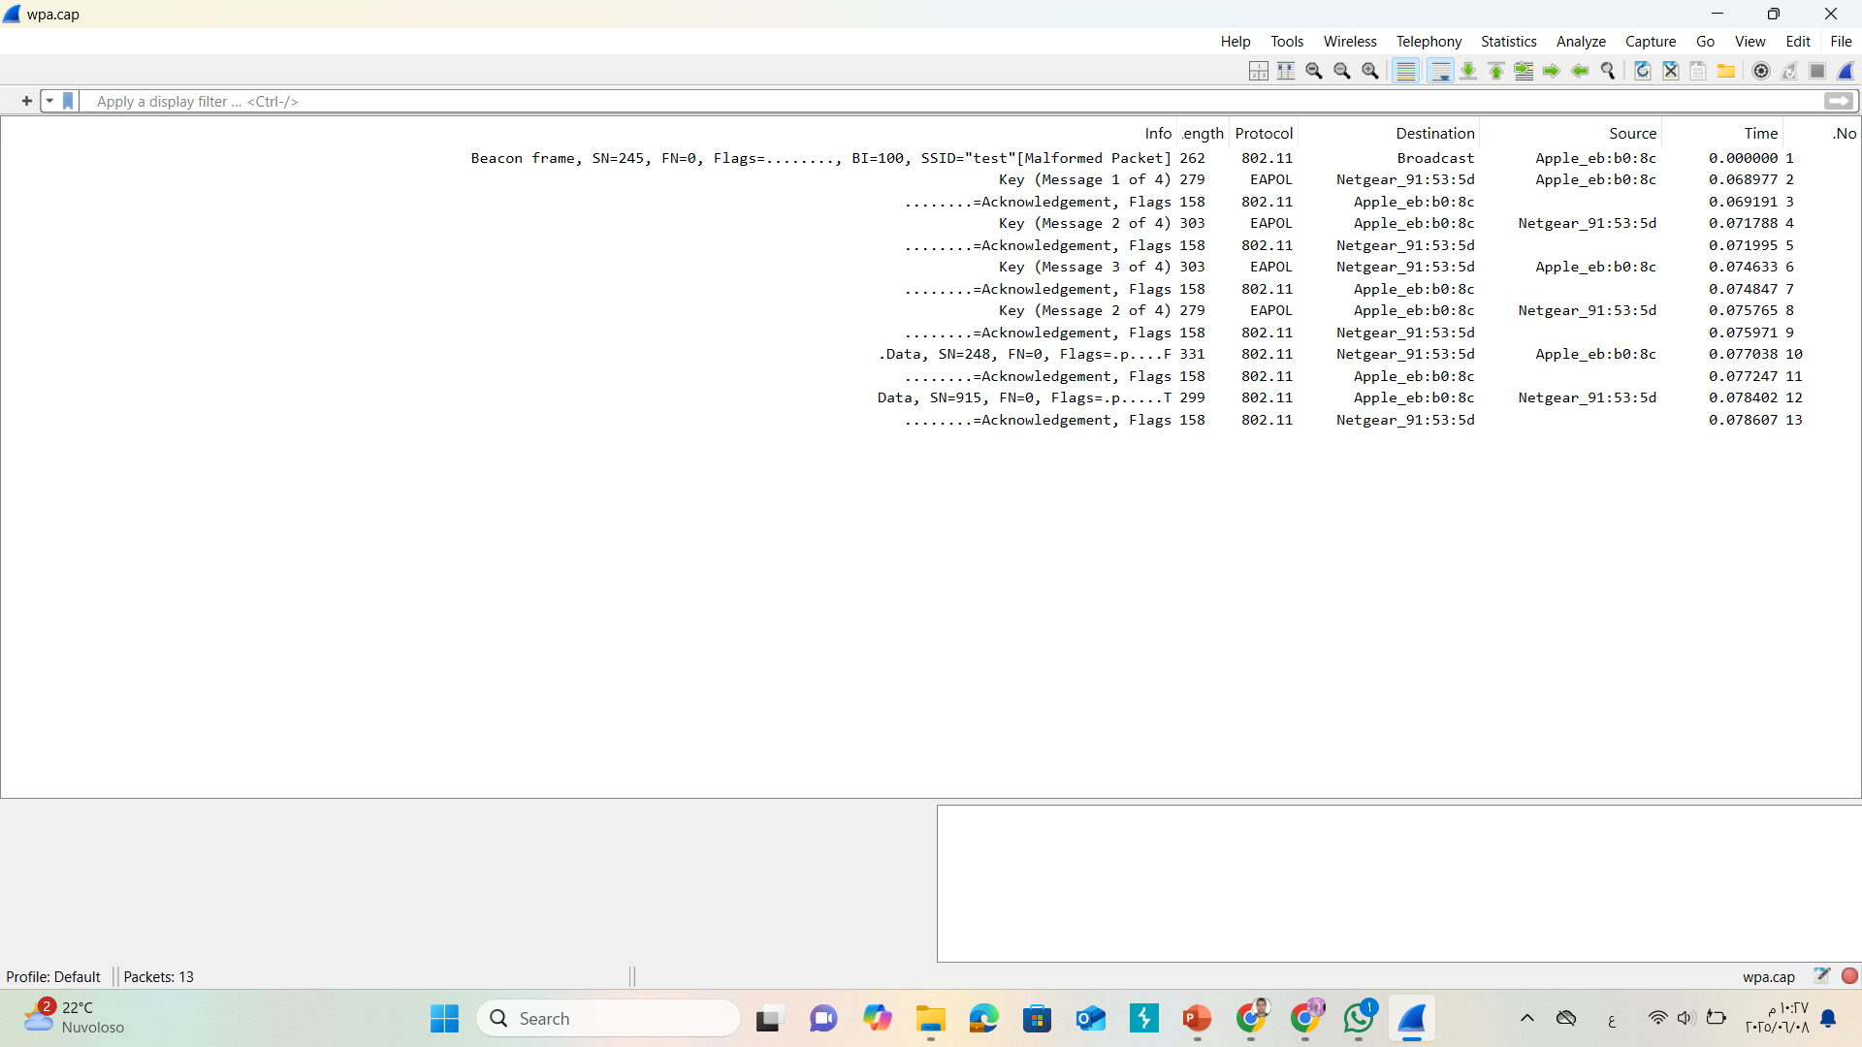



Slide 8
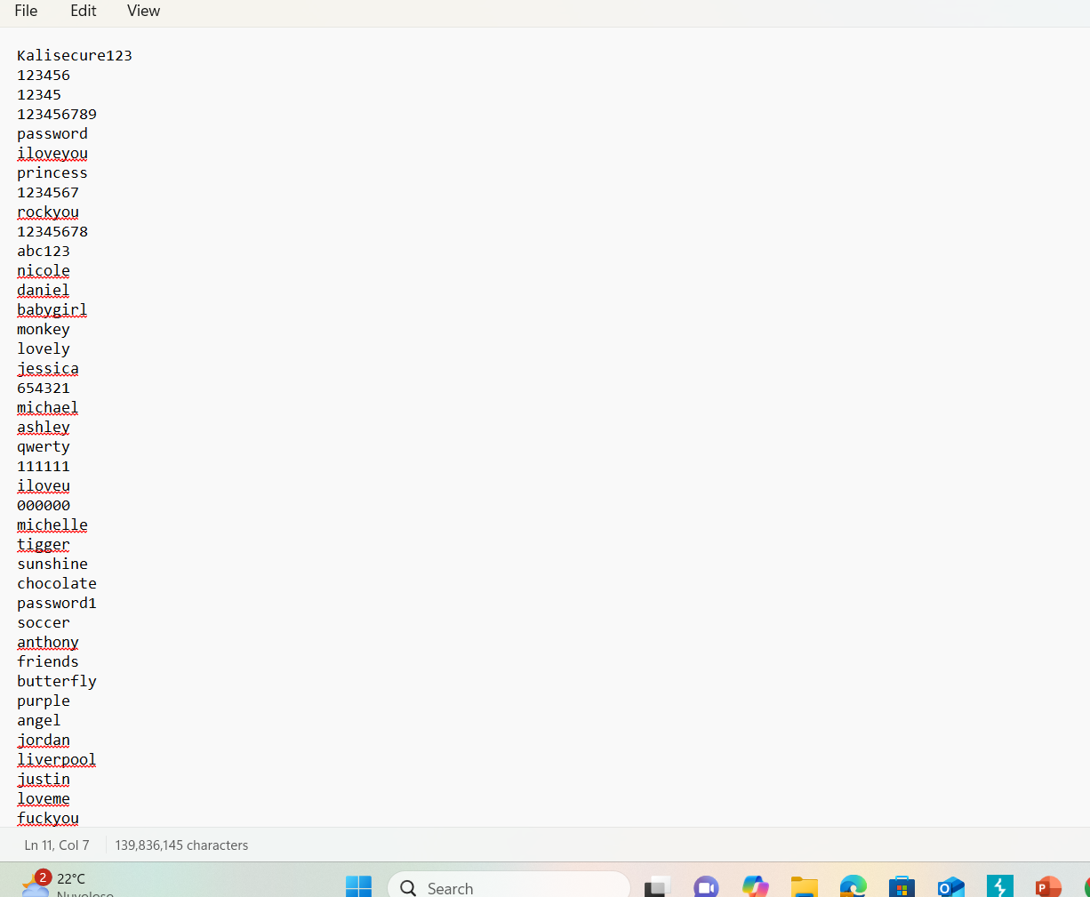


Slide 9
Results:
The handshake was successfully captured.
Password testing was initiated using Aircrack-ng.
.\aircrack-ng D:\SYSS\ICT\project\wifi-crack\wpa.cap -w D:\SYSS\ICT\project\wifi-crack\rockyou.txt
The password was discovered: biscotte
The result highlights how weak passwords can be easily cracked when using a prepared wordlist.

Slide 10
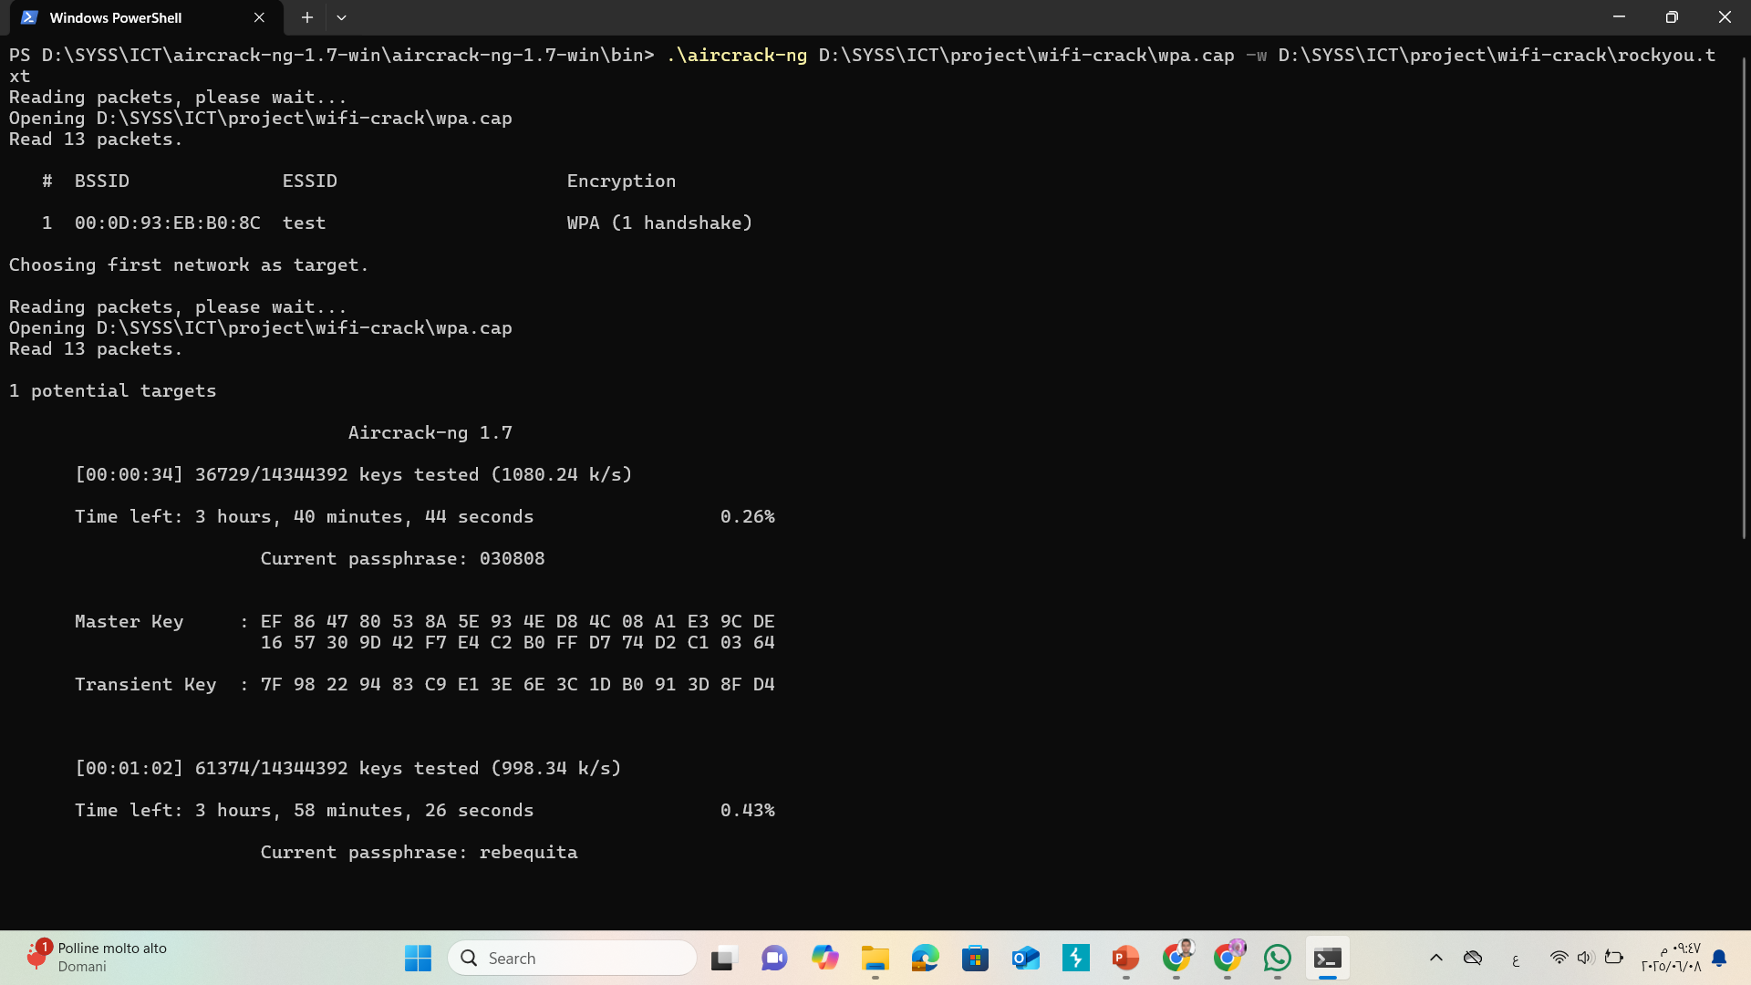

Slide 11
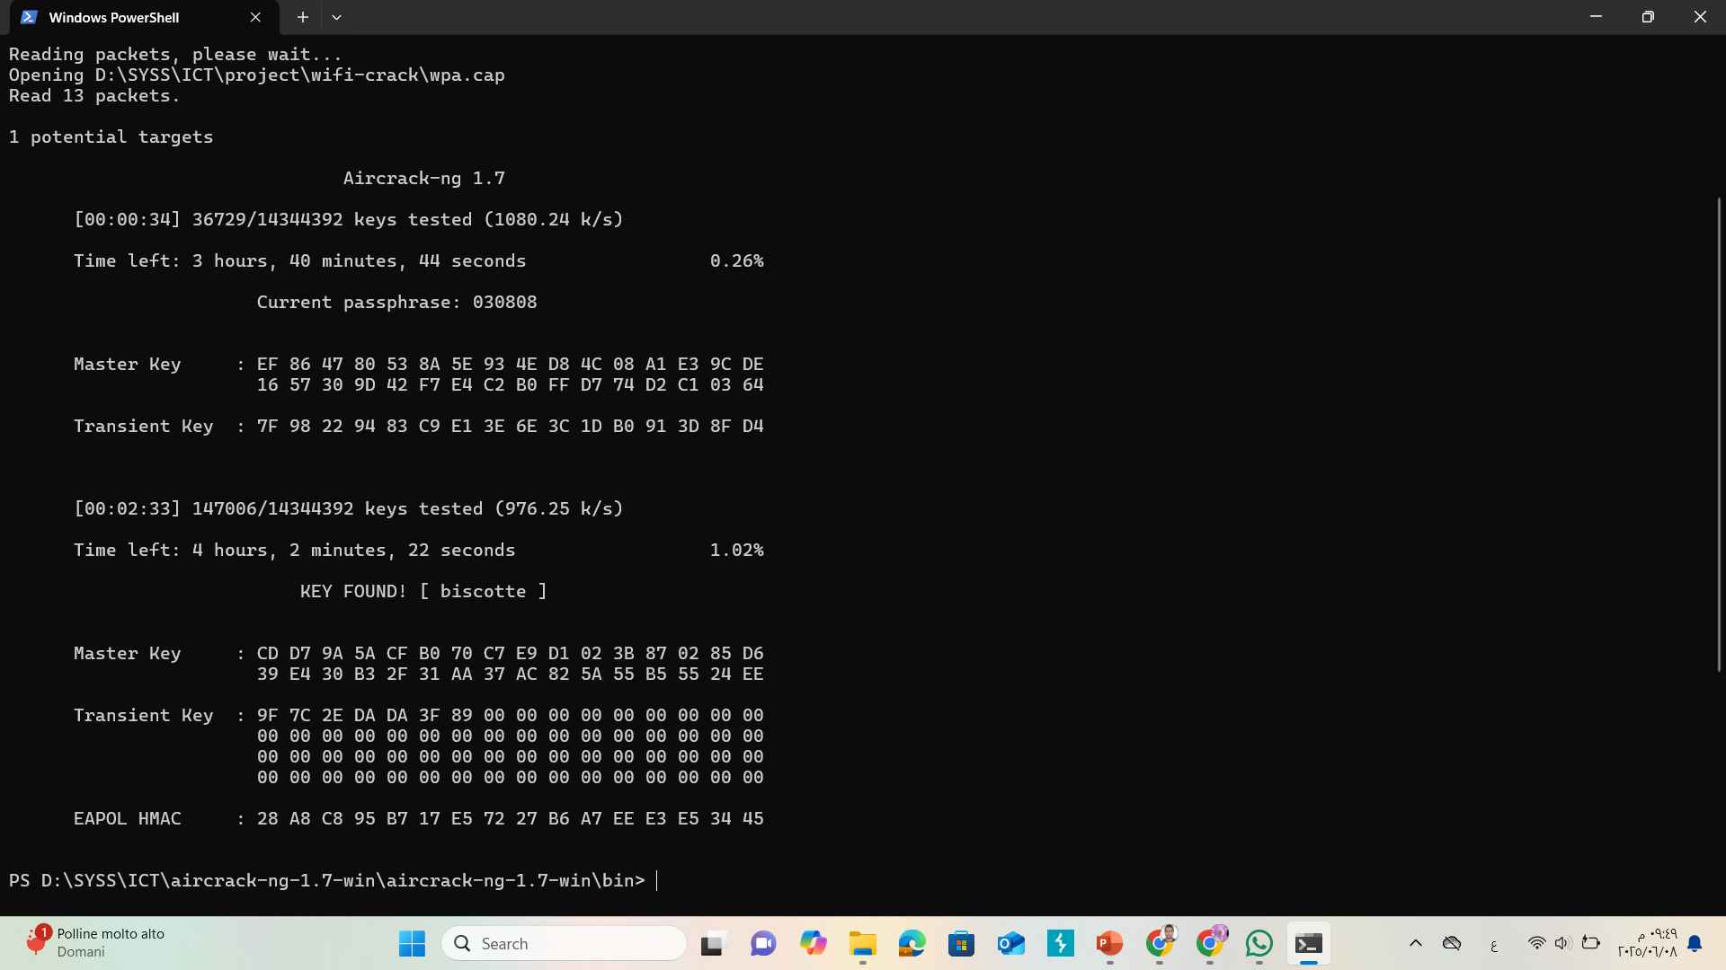

Slide 12
Challenges:
Windows does not natively support monitor mode.
Using Aircrack-ng on Windows requires precise file formatting and correct paths.
The effectiveness of the attack heavily depends on the quality of the wordlist.

Slide 13

Conclusion:
Wi-Fi security is not guaranteed if weak passwords are used.
Free tools can effectively reveal vulnerabilities with relative ease.
Recommendations: Use strong passwords, enable WPA3 when possible, and avoid public networks without a VPN.

Slide 14
Thank You!

